Slide 1
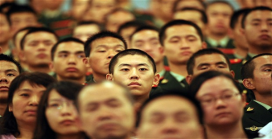
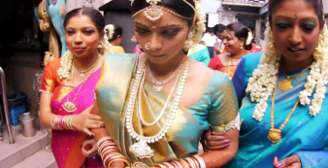

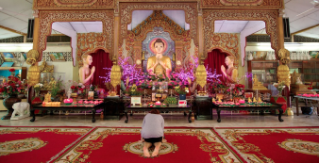
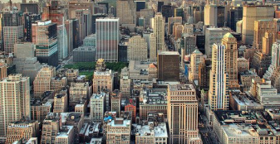
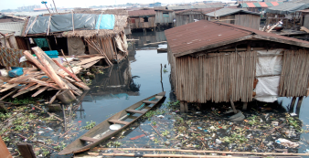

The Asian Diversity
How do you bridge a diverse region ?
Culture/Ethnic
Belief/Religion
Costs/Economy
Only Dextrans knows how !
Asia – leading the world into the new century
300 ethnically different communities
300 different languages
3,000 different people groups
3,300 million people
33 trillion dollars GDP economy
Dextrans – Integrating the Asian Frontier

